Slide 1
chronic venous insufficiency (CVI)

Slide 2

Chronic venous insufficiency (cvi)
Long-standing functional problems of veins that leads to:
  Swelling, changes of skin and/or leg ulcers
Etiology/Pathophysiology
  Varicose veins and post-thrombotic syndrome can lead to CVI
  Venous hypertension
  Enzymes in tissue destroy RBCs, causing the release of hemosiderin
  Fibrous tissue
  Development of venous leg ulcers is unknown

Slide 3
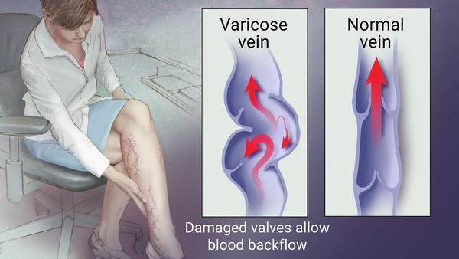
CVI: Clinical manifestations & complications
Clinical manifestations
  Lower extremity skin is leathery/brownish color
  Edema is present
  Eczema/itching
  Painful ulcers
Complications
  Venous ulcer
  Drainage of ulcers (yellow slough and irregular wound edges)
  Osteomyelitis
  Malignant changes
  Amputations (rare)

Slide 4
CVI: Interprofessional care
Compression therapy
  Compression stockings (TED hose)/assess patient to make sure they do not have PAD before apply stockings
Moist dressing
Nutrition therapy
  High in protein
  Eat foods high in vitamin A, C and zinc/take supplements
  Tight glucose control for diabetic patients
Antibiotics for wound infection- should be guided by wound culture results
  Systemic antibiotics
Skin replacement/skin grafts
Wound debridement and excision

Slide 5
Cvi: Nursing management
Assess wound(s) for signs of infection with each dressing change
Teach patients how to correctly apply compression stockings and have them demonstrate the skill back to you
Prescription stockings should be worn daily to prevent venous ulcers from reoccurring
Teach proper skin care
Daily moisturizers for eczema
Educate patient to avoid staying in one position for long periods of time; leg exercises
Educate patient to elevate their legs (above heart level)
Encourage daily walking when ulcer heals

Slide 6
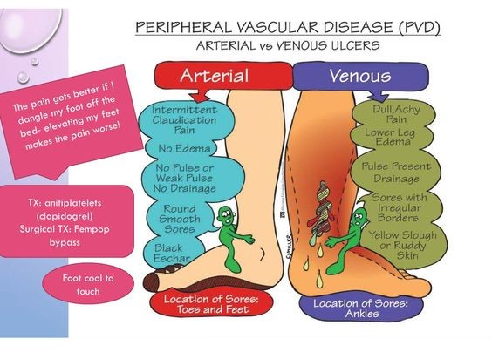

Slide 7
Reference
Wipke-Tevis, D. D., & Rich, K. A. (2017). Vascular Disorders (10th ed.). In S. L. Lewis, L. Bucher, M. M. Heitkemper, & M. M. Harding (Eds), Medical-surgical nursing: Assessment and management of clinical problems (pp. 802-831). St. Louis, Missouri: Elsevier Inc.

